Slide 1


Breast Cancer Diagnosis
BA305 A1
Evaluating the effectiveness of FNA Biopsy Scans
Presented by Yilan Ruan, Brian Park, Shunnosuke Kanematsu

Slide 2

Why are we doing breast cancer diagnosis?
Benefits of UI
?
Which models are the most appropriate for FNA biopsy diagnosis?
Overarching question
Introduction
Process
1 in 8 Women are affected by breast cancer in the US alone
$2500
Breast Cancer accounts for 30% of all cancer
Analysis
Avg biopsy cost
Conclusion

Slide 3
Dataset Description
2
Data origins (Kaggle)
Introduction
features are computed from a digitized image of a fine needle aspirate (FNA) of a breast mass
Process
Decision Trees conducted to narrow down attributes -> high accuracy scores
Analysis
Entities
569
Attributes
33
Entities
569
Attributes
22
Conclusion
Notes:
The data came preprocessed through a decision tree thus we have a high accuracy.

Slide 4
Our approach
Goal
Data Processing
Experimental Methods deployed
Identify and evaluate models that may assist in breast cancer diagnosis.
Dropped Standard Error Columns
Introduction
KNN
Decision Tree
Process
Dummy Diagnostic Column
63% Benign
37% Malignant
Analysis
Naive Bayesian
Dataset 1 Worst
Dataset 2 Mean
Dataset 3 Both
Conclusion

Slide 5
How do the models all compare?
 | K-NN Cluster = 13 | Decision Tree | Naïve Bayes
Accuracy % with Mean | 93.4% | 88.6% | 85.96%
Accuracy % with Worst | 96.9% | 93.8% | 89.47%
Accuracy % with Both | 96.49% | 91.2% | 91.23%
Introduction
Process
Analysis
Conclusion
*High accuracy score derives from the data being preprocessed in a decision tree that selected these relevant attributes/features.

Slide 6
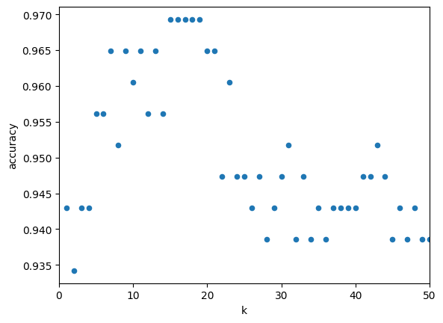
K-NEAREST NEIGHBORS (KNN) (WORST)
K | Accuracy
9 | 0.964912
10 | 0.960526
11 | 0.964912
12 | 0.956140
13 | 0.964912
14 | 0.956140
15 | 0.96929824
16 | 0.969298
17 | 0.969298
18 | 0.969298
Introduction
Process
Analysis
 | Pos | Neg
Pos | 141 | 2
Neg | 10 | 75
This dataset had the lowest false negatives vs 12 (Mean dataset)
Conclusion

Slide 7
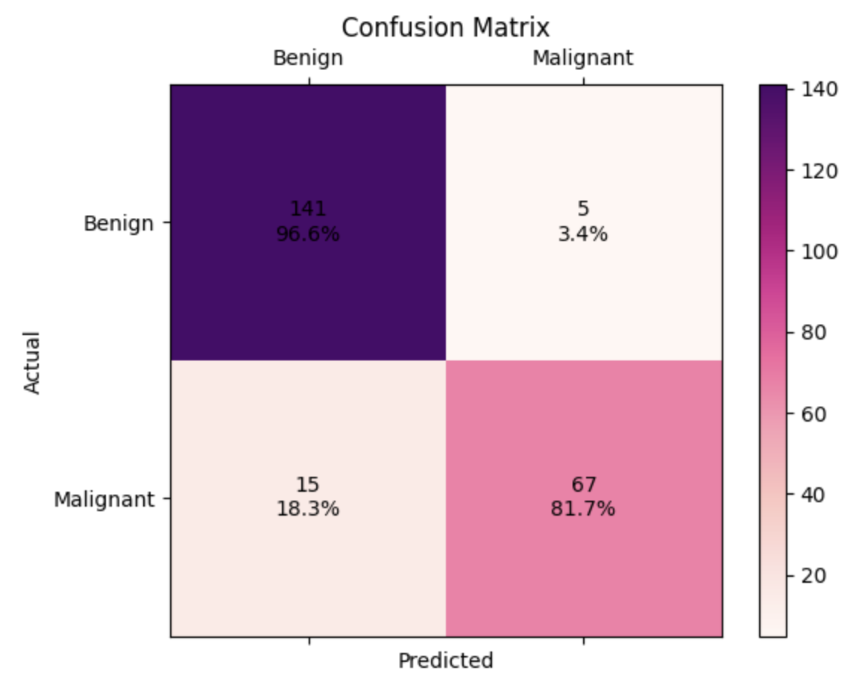
NAÏVE BAYES (WORST)
Accuracy: 91.23%
Introduction
141
96.6%
Strength: Accuracy of 91.23% indicates a high-performance model; baseline is 62.74%
Weakness: Isn’t able to capture complex relationships as well as other models
Process
Analysis
Conclusion
Notes:
Interpretability: The Naive Bayes algorithm is generally considered to be interpretable, as it calculates the conditional probability of a class given the feature values. This can aid in understanding the underlying mechanisms and factors contributing to breast cancer classification, which can be useful for explaining the model's predictions to stakeholders and gaining their trust.
Potential Clinical Application: The high accuracy score indicates that the model has the potential to be clinically useful in assisting medical professionals with breast cancer classification. It may serve as a valuable tool in supporting clinical decision-making and patient management in a real-world clinical setting.

Slide 8
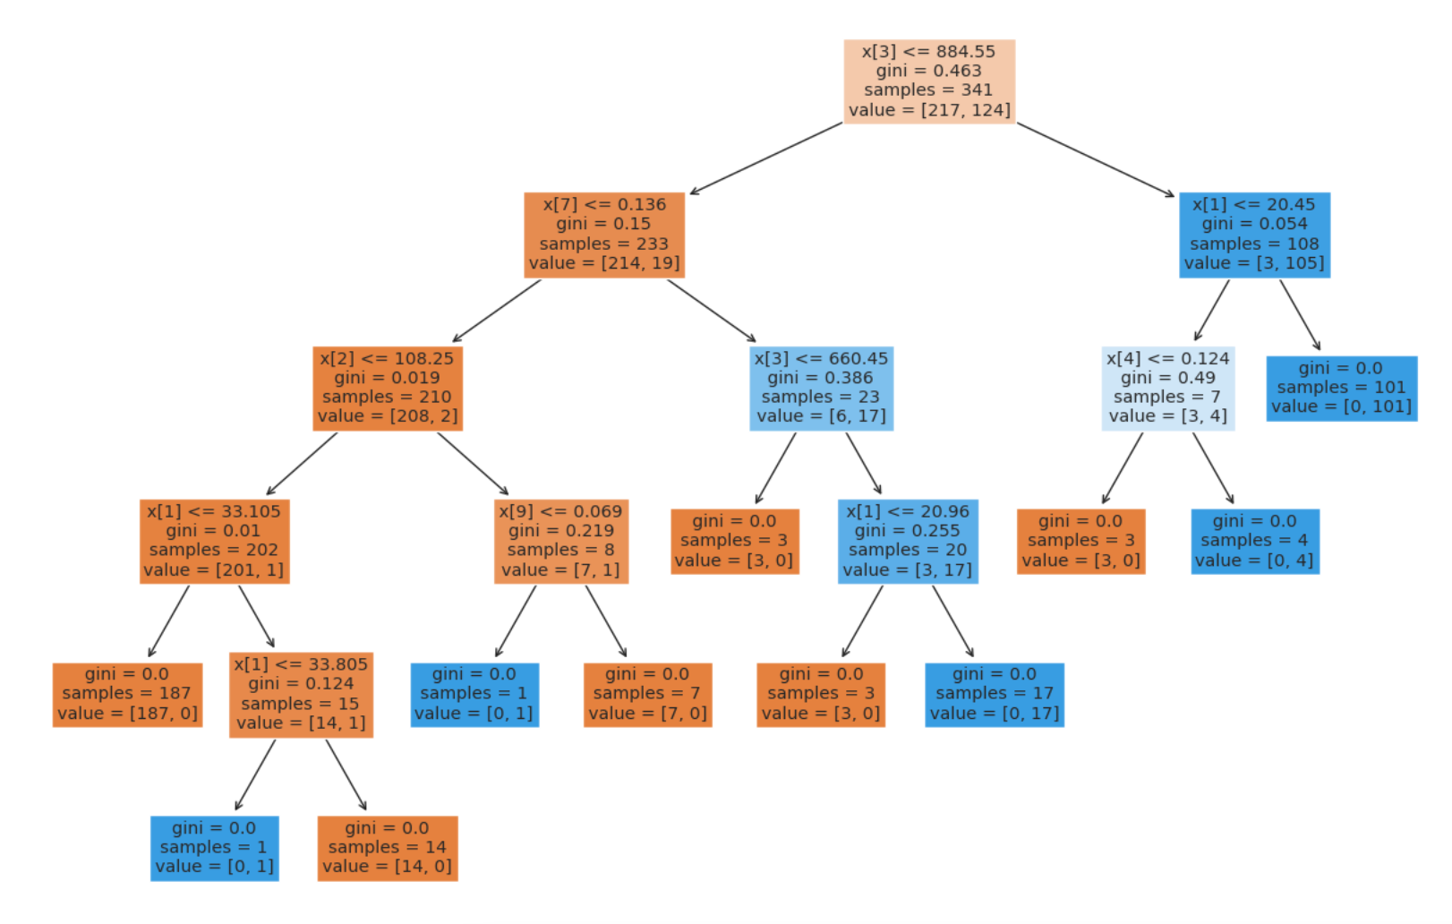
DECISION TREES: FULL TREE (WORST)
Accuracy Score: 89.5%
Number of Classes: [2]
Number of Features: 10
Number of Leaves: 21
Number of Nodes: 11
Number of Maximum Depth: 5
Introduction
Process
Analysis
Conclusion

Slide 9
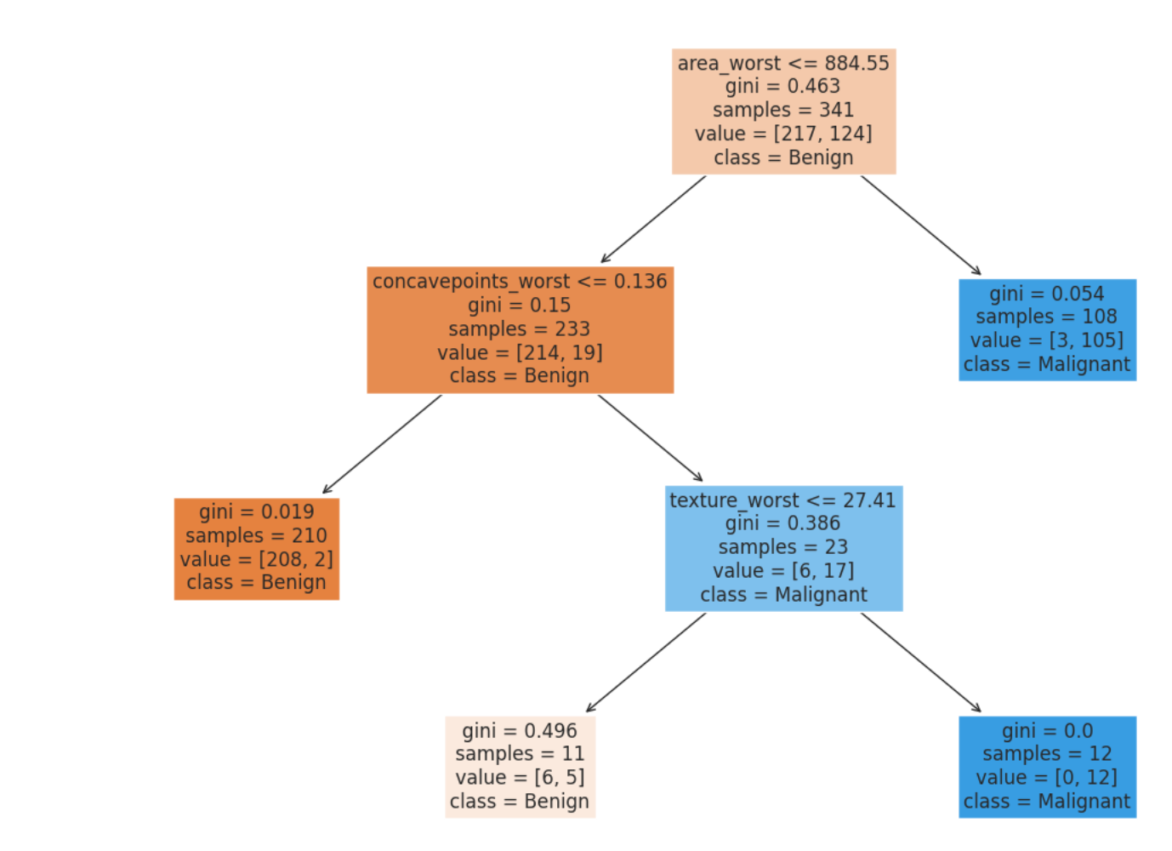
DECISION TREE: REDUCED TREE (WORST)
Accuracy Score: 93.8%
Number of Classes: [2]
Number of Features: 10
Number of Leaves: 7
Number of Nodes: 4
Number of Maximum Depth: 3
Introduction
Process
Analysis
Conclusion

Slide 10
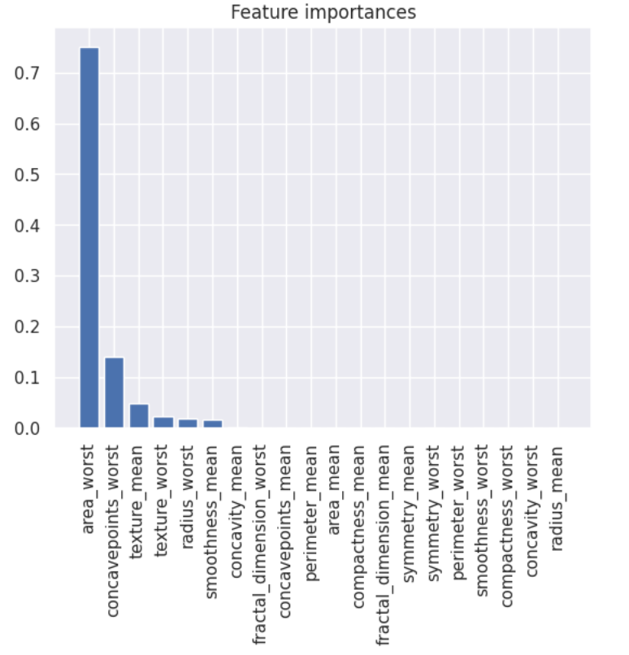
DECISION TREE: REDUCED TREE (WORST)
Introduction
“_worst” attributes populate the majority of the most important features
Process
Analysis
Conclusion

Slide 11



NEXT STEPS
1
2
Exploratory Data Analysis
3
Compare Data Across Different Biopsies
Fine Tune Accuracy Scores
Introduction
We can use other metrics to validate our models such as precision, recall, F1 score, and area under the receiver operating characteristic curve (AUC-ROC).
This can involve visualization techniques such as scatter plots, histograms, and box plots, as well as statistical tests to evaluate differences between groups.
With FNA being the cheapest, it is also the method with the highest room for error. Comparing the accuracy of other methodologies will help distinguish which combination of method+models is the most efficient.
Process
Analysis
Conclusion
Notes:
The "worst" features generally reflect the most severe instances of certain features in the cells, such as worst concavity, worst texture, or worst symmetry, whereas the "mean" features reflect the average value of these features across all cells in the sample.

Slide 12
THANK YOU!

